Slide 1
Image Analysis
Jay Kancherla
https://github.com/jkancher/Image-Analysis

Slide 2
Materials:
Raspberry Pi 3 Model B
Power Supply, HDMI
3 USB Webcams
USB Keyboard
Monitor with Power Supply
Motioneye OS (https://github.com/ccrisan/motioneyeos/wiki/Installation)
2 Ethernet cables
PC/Desktop
Python 2.7.6
Dropbox API
Watson IBM API
Notepad++

Slide 3
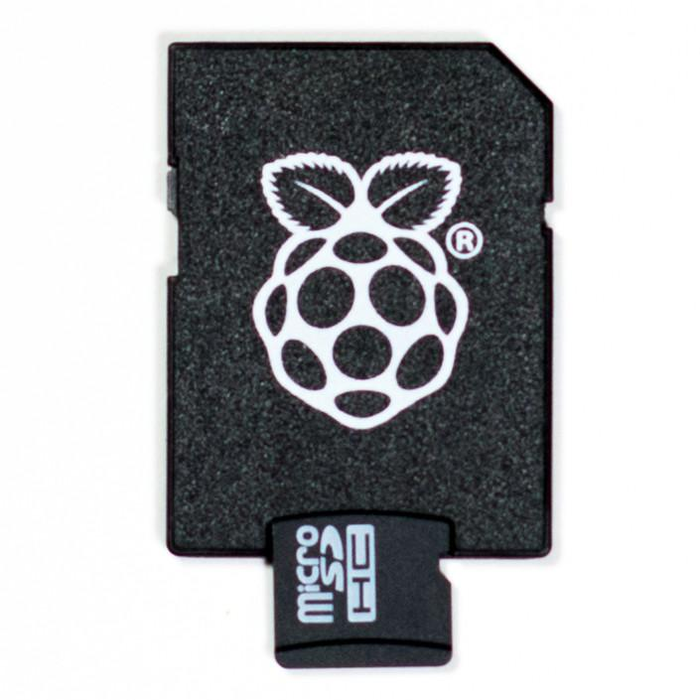
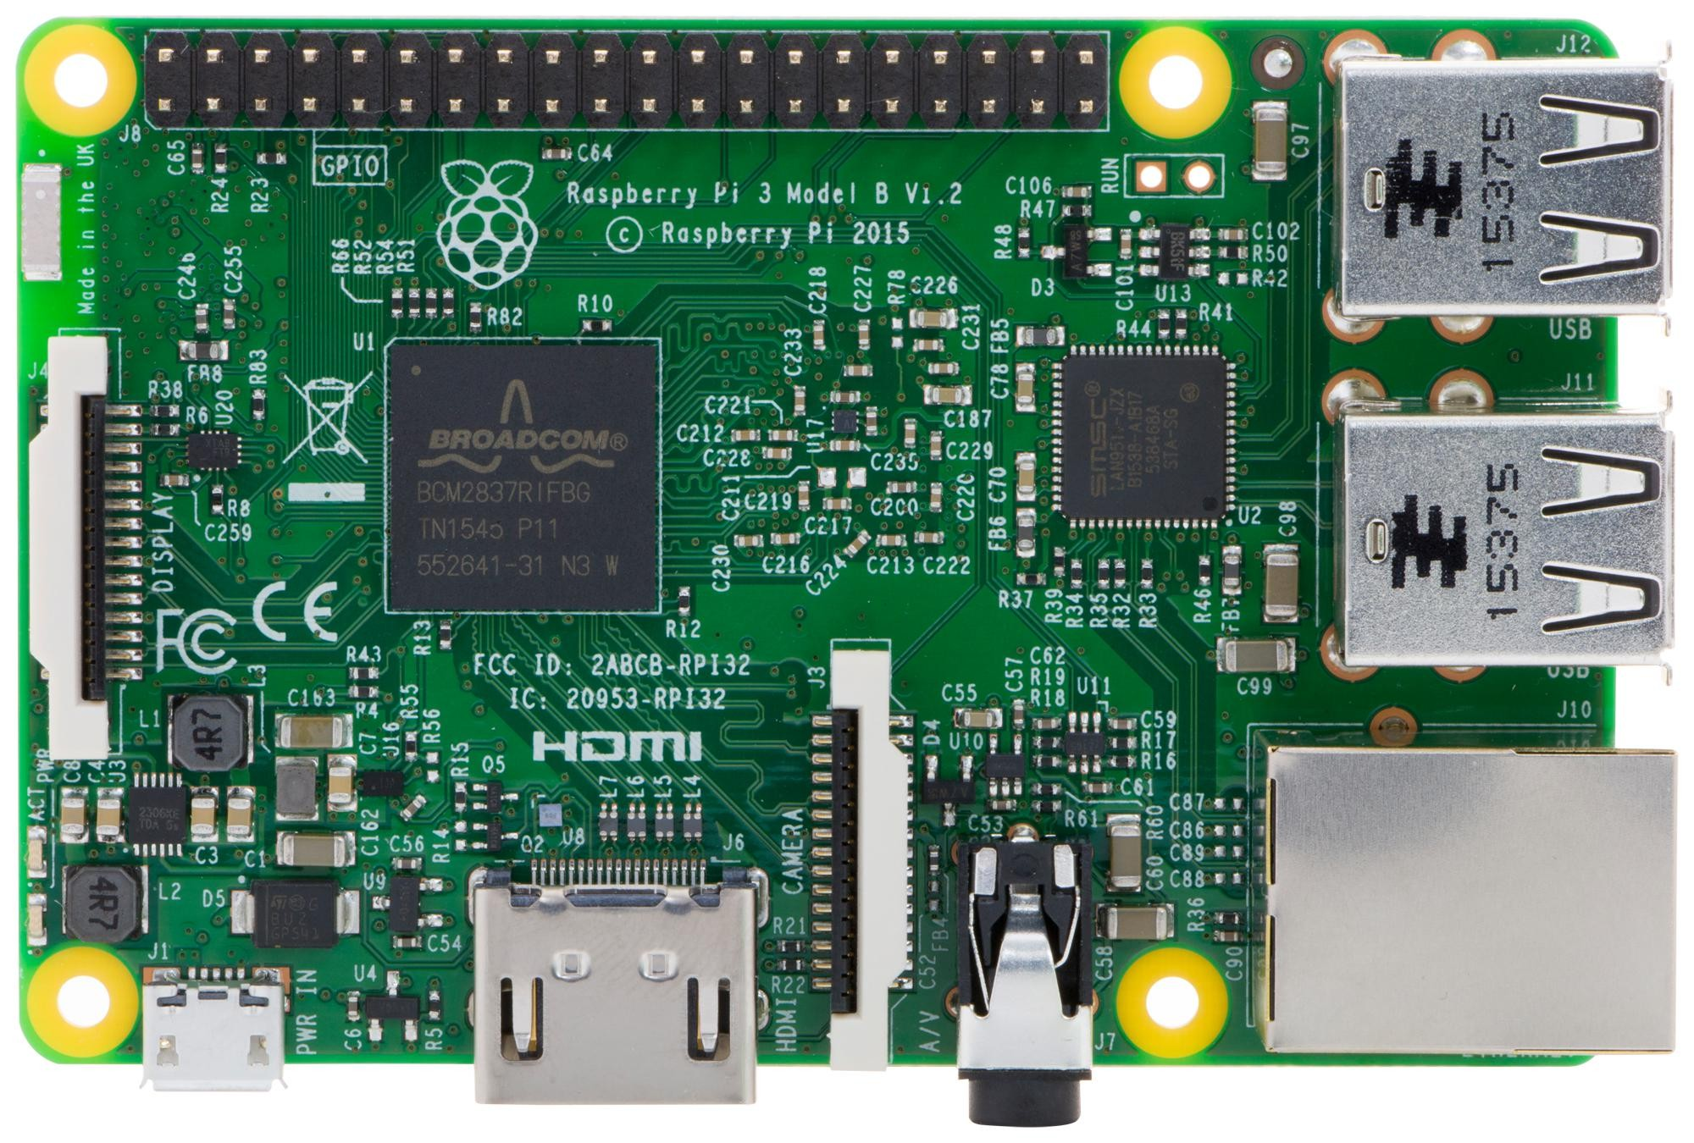


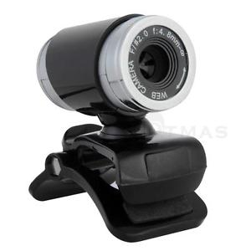
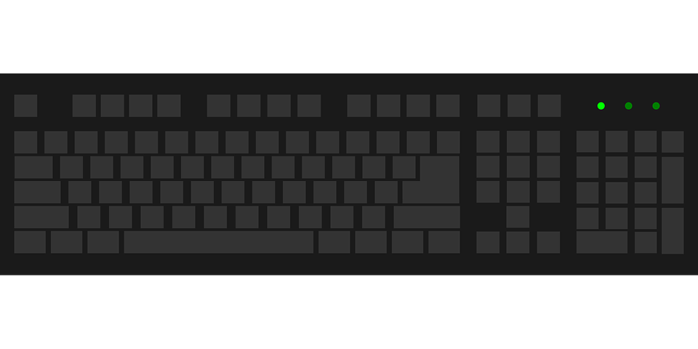
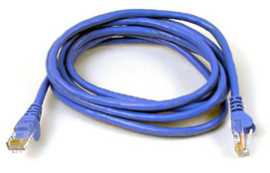
Setup
Motioneye OS on micro SD card

Slide 4
Start Motioneye OS
Turn on raspberry pi with micro SD card with the software motioneye
The raspberry pi will automatically run the motioneye OS
A Ethernet cable must be plugged in
Type in “ifconfig” or “ipconfig” to get the Ethernet address and input the address in your url on an internet browser in your laptop

Slide 5
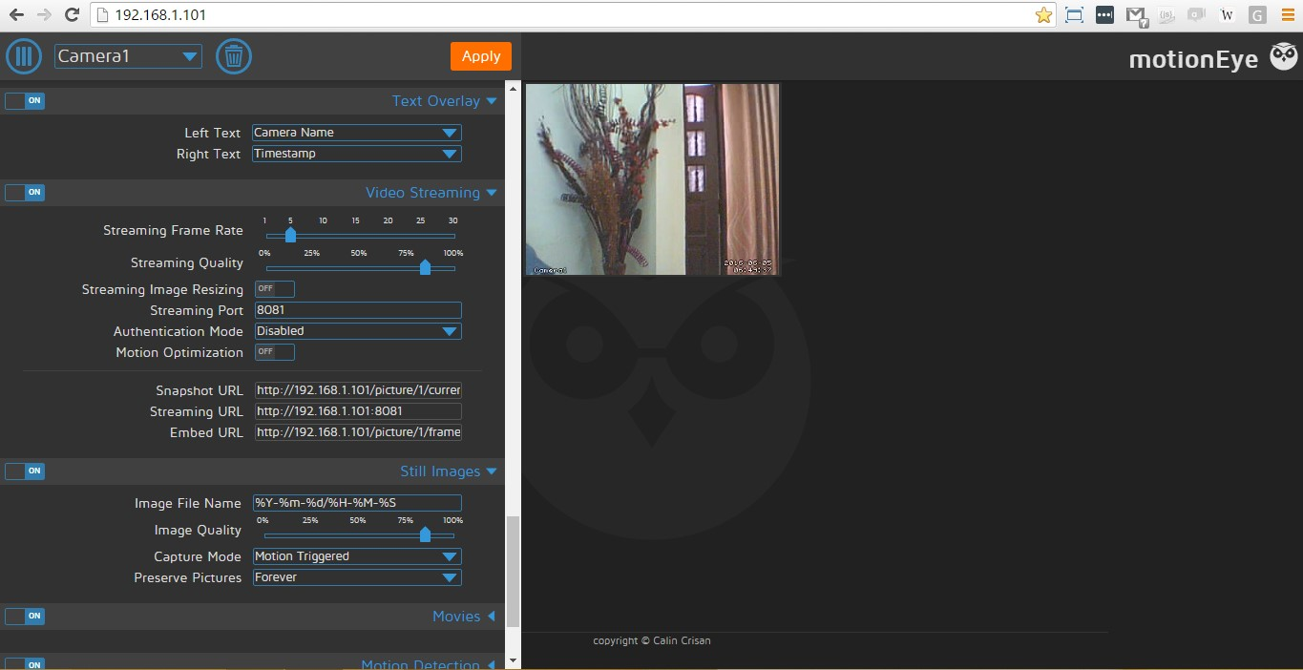
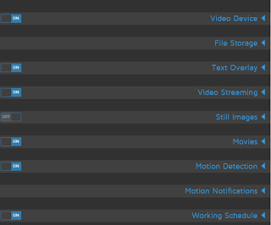
Motioneye OS

Slide 6
Saving/Capturing Images
On Motioneye from your laptop
Username: admin
Password: There is no password just click enter
Change the internet connection to wireless if needed
Under the menu, go to file storage
Toggle upload media files
Enter the root directory for Dropbox account
Go to still images and toggle it on
Change interval times to a certain time you want a images clicked and saved to Dropbox (every 1 minute, every 5 minutes)

Slide 7
Dropbox App
Create a Dropbox account (www.Dropbox.com)
Insert all the images you want to compare in your Dropbox. Can be in a folder or on the main dashboard of your Dropbox.
Create a Dropbox app that gives access to your entire Dropbox or Dropbox file with your images.
Obtain the app key and secret key on your Dropbox app
Generate and obtain the generated token from your Dropbox app

Slide 8
Watson IBM API
Go to Watson IBM and create an account (https://www.ibm.com/cloud-computing/bluemix/)
Go to IBM Bluemix account page
Create a new service
The service should be under Watson called Visual Recognition
Create the service
Obtain the api key for that service once created

Slide 9
Python (2.7.6)
Authorize Dropbox connection
Need app key, secret key, and generated token key
View folders in Dropbox if needed
Ask user for location of first image
Use Watson IBM Visual Recognition to identify the image
Need Watson API key
Store the main result of the first image analysis
Ask user for location of second image
Store the main result for the second image analysis
Tell user whether the product in the image has been taken

Slide 10
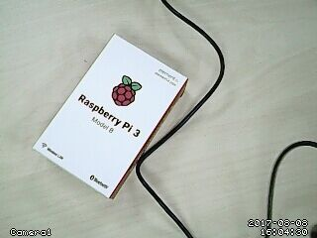
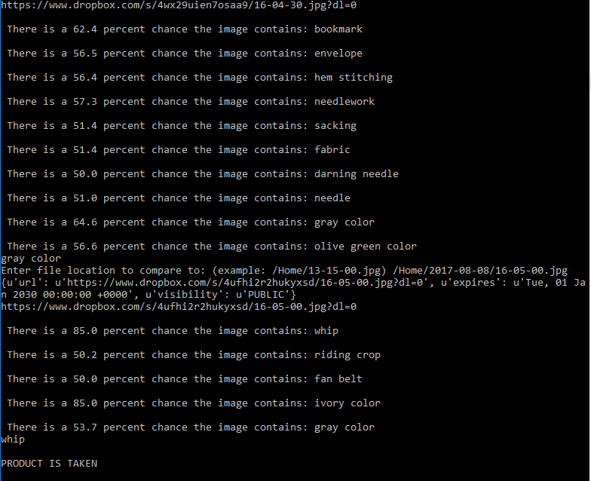
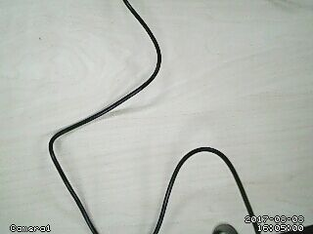
Example

Slide 11
Trial and Error
Using a Visual recognition API for images without paying money is hard to find
Motioneye OS times out at sporadic times, not clicking images at interval times
Getting the API keys to work with the program
Importing the right packages to the code
Finding a sufficient image analysis software that reads pictures clearly

Slide 12
Next Steps
Find a way to import a file or a bunch of pictures at once after asking user what file of images to search or analyze
Determine if any images are missing the product by analyzing all the images in the file

Slide 13
Thank You

